Slide 1
Visualisation And Narratives
Heena Solanki
Covid 19 Dashboard
heena.solanki@cognizant.com
7011578415

Slide 2
Project KPI Overview
KPI Name | KPI Expression
TotalConfirmed | sum( {<Date={'$(=$(vToday))'}>}(Confirmed))
TotalActive | sum( {<Date={'$(=$(vToday))'}>}(Active))
TotalRecovered | sum( {<Date={'$(=$(vToday))'}>}(Recovered))
TotalDeaths | sum( {<Date={'$(=$(vToday))'}>}(Deaths))
TodayActive | sum( {<Date={'$(=$(vToday))'}>}(Active))-sum( {<Date={'$(=$(vYesterday))'}>}(Active))
TodayConfirmed | (sum( {<Date={'$(=$(vToday))'}>}(Confirmed))-sum( {<Date={'$(=$(vYesterday))'}>}(Confirmed)))
TodayDeaths | (sum( {<Date={'$(=$(vToday))'}>}(Deaths))-sum( {<Date={'$(=$(vYesterday))'}>}(Deaths)))
TodayRecovered | (sum( {<Date={'$(=$(vToday))'}>}(Recovered))-sum( {<Date={'$(=$(vYesterday))'}>}(Recovered)))

Slide 3
KPI NAME | KPI EXPRESSION
% Change Since Yesterday Active | ((sum( {<Date={'$(=$(vToday))'}>}(Active))-sum( {<Date={'$(=$(vYesterday))'}>}(Active)))/(sum( {<Date={'$(=$(vYesterday))'}>}(Active))))*100
% Change Since Yesterday Deaths | ((sum( {<Date={'$(=$(vToday))'}>}(Deaths))-sum( {<Date={'$(=$(vYesterday))'}>}(Deaths)))/(sum( {<Date={'$(=$(vYesterday))'}>}(Deaths))))*100
% Change Since Yesterday Recovered | ((sum( {<Date={'$(=$(vToday))'}>}(Recovered))-sum( {<Date={'$(=$(vYesterday))'}>}(Recovered)))/(sum( {<Date={'$(=$(vYesterday))'}>}(Recovered))))*100
% Change Since Yesterday Confirmed | ((sum( {<Date={'$(=$(vToday))'}>}(Confirmed))-sum( {<Date={'$(=$(vYesterday))'}>}(Confirmed)))/(sum( {<Date={'$(=$(vYesterday))'}>}(Confirmed))))*100

Slide 4
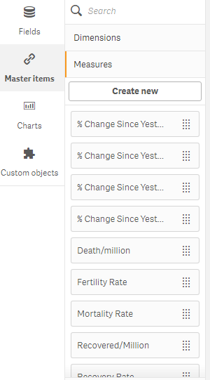
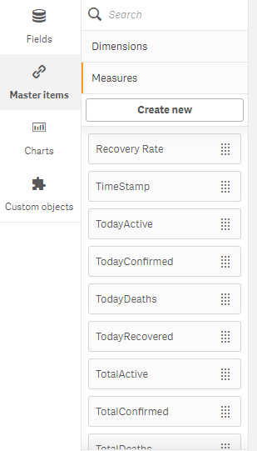
Screenshot Of KPI’s And Master Measures

Slide 5
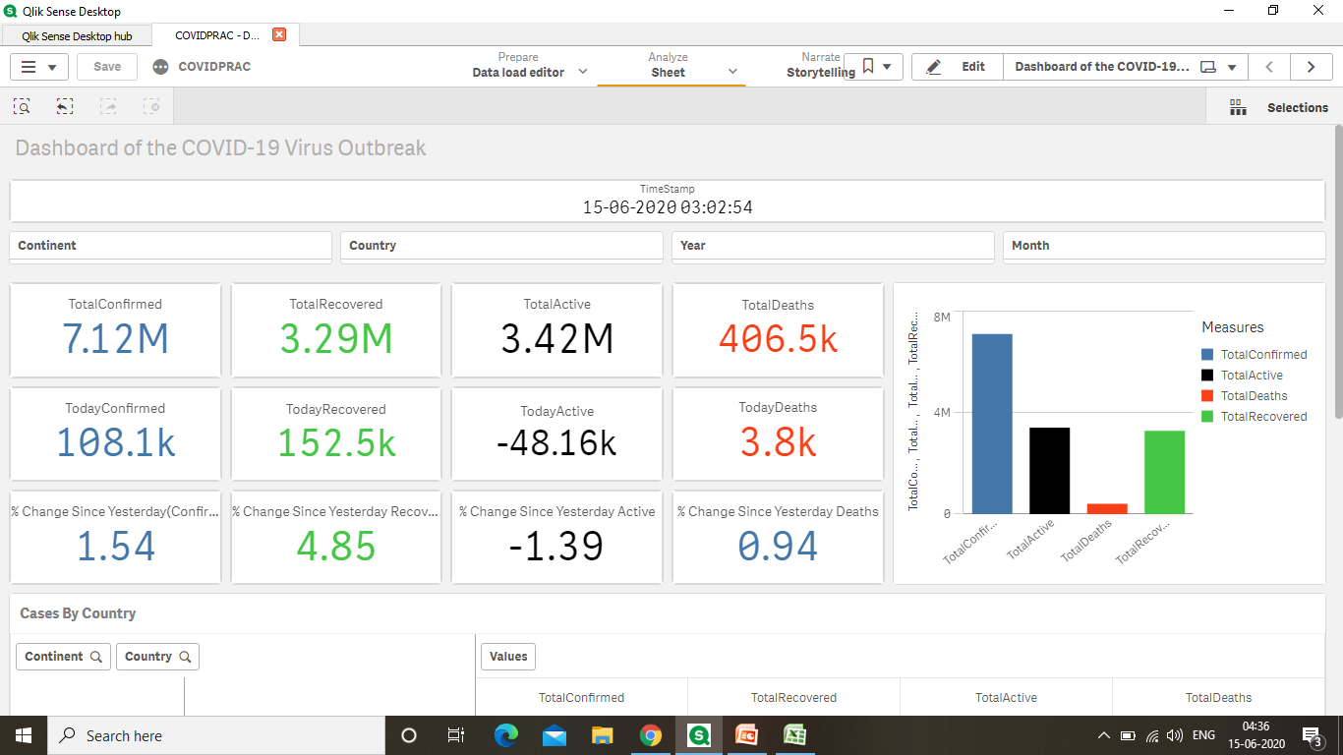
KPI View

Slide 6
Business Case
In this dashboard we provide an up-to-date overview of the Spread of the COVID-19 around the globe.
Although the number of new confirmed cases has been declining in China, the outbreak is far from over as the epicenter has shifted to Europe and more recently the US.

Slide 7
List Of Measures
Measure Name | Measure Expression
Death/Million | sum( {<Date={'$(=$(vToday))'}>}(Deaths))/Sum(Population)
Recovered/Million | sum( {<Date={'$(=$(vToday))'}>}(Recovered))/Sum(Population)
TestCount/million | Sum(TotalTests)/Sum(Population)
Fertility Rate | Sum([Fert. Rate])/Sum(Population)
Recovery Rate | (sum( {<Date={'$(=$(vToday))'}>}(Recovered)))/(sum(Population))
Mortality Rate | (sum( {<Date={'$(=$(vToday))'}>}(Deaths)))/(sum(Population))
TimeStamp | $(vTimeStamp)

Slide 8
Measure Name | Measure Expression
Death per 10 Million | (sum( {<Date={'$(=$(vToday))'}>}(Deaths))/Sum(Population))*10
Recovered per 10 Million | (sum( {<Date={'$(=$(vToday))'}>}(Recovered))/Sum(Population))*10

Slide 9
List of Dimensions
Dimension Name
Continent-Country Drill Down
Month-Day Drill Down
Country
Continent
Month

Slide 10
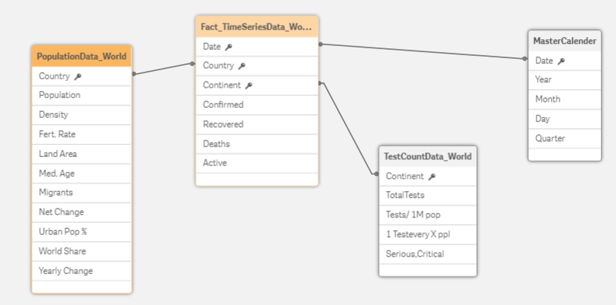
Data Model

Slide 11
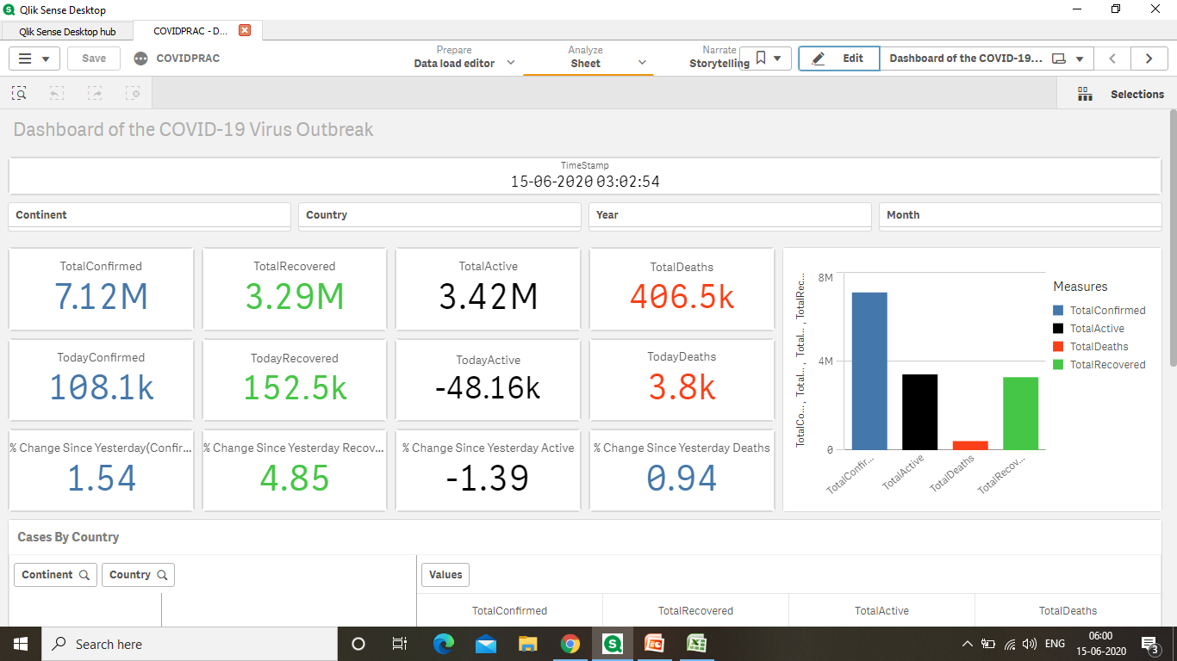
Dashboard

Slide 12
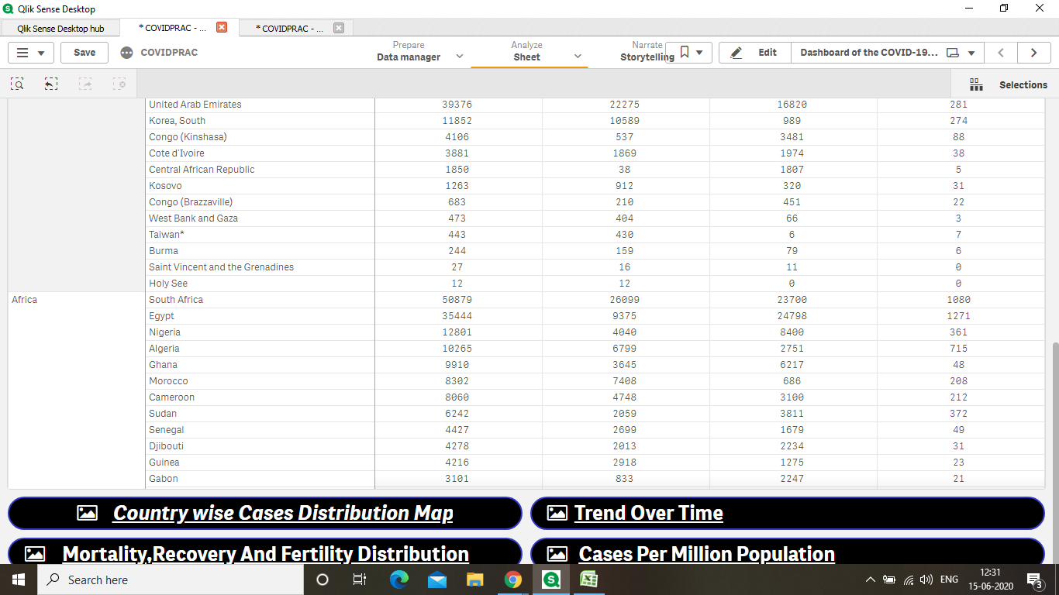

Slide 13
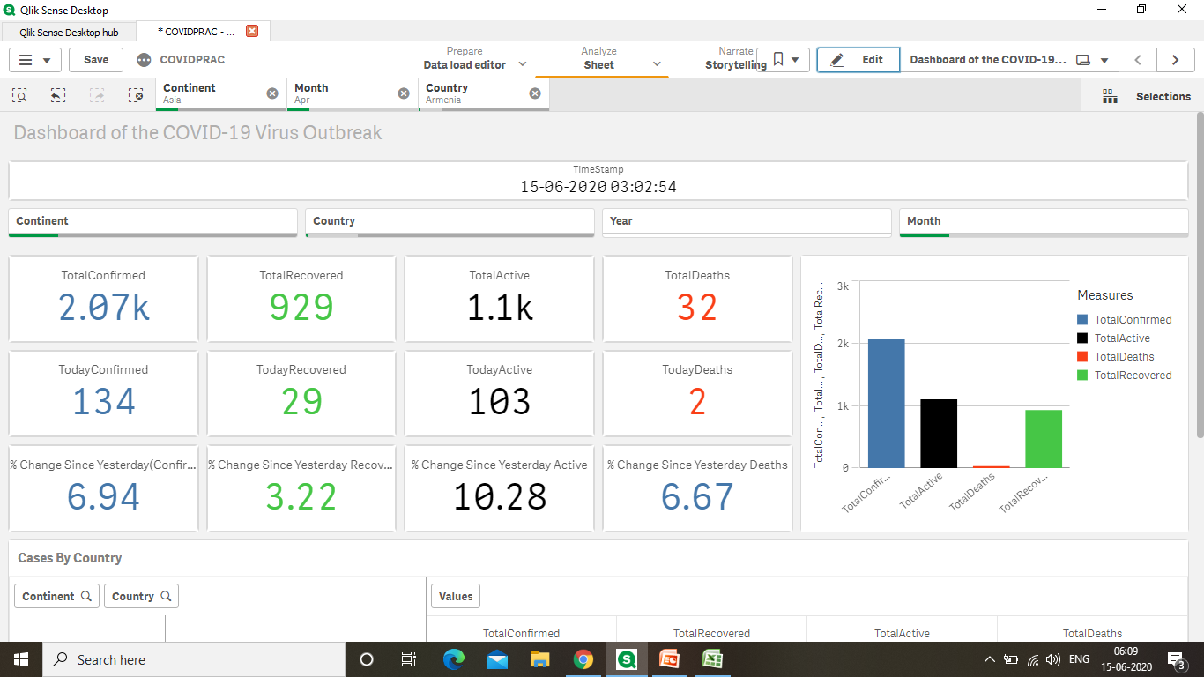

Slide 14
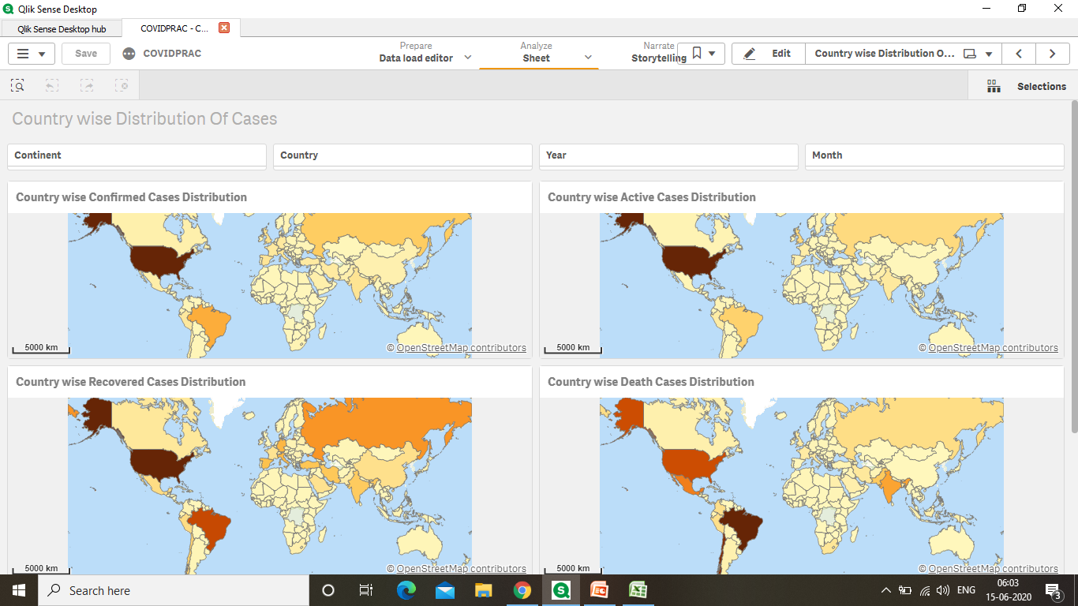
Country wise Cases Distribution

Slide 15
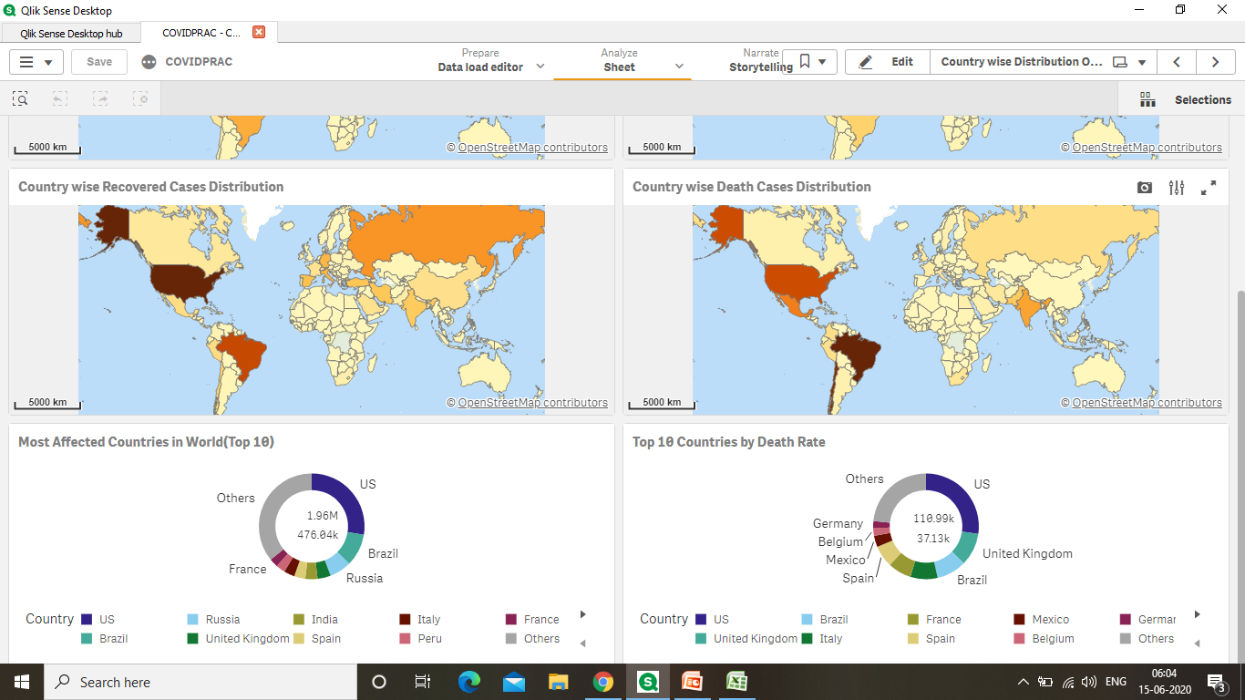

Slide 16
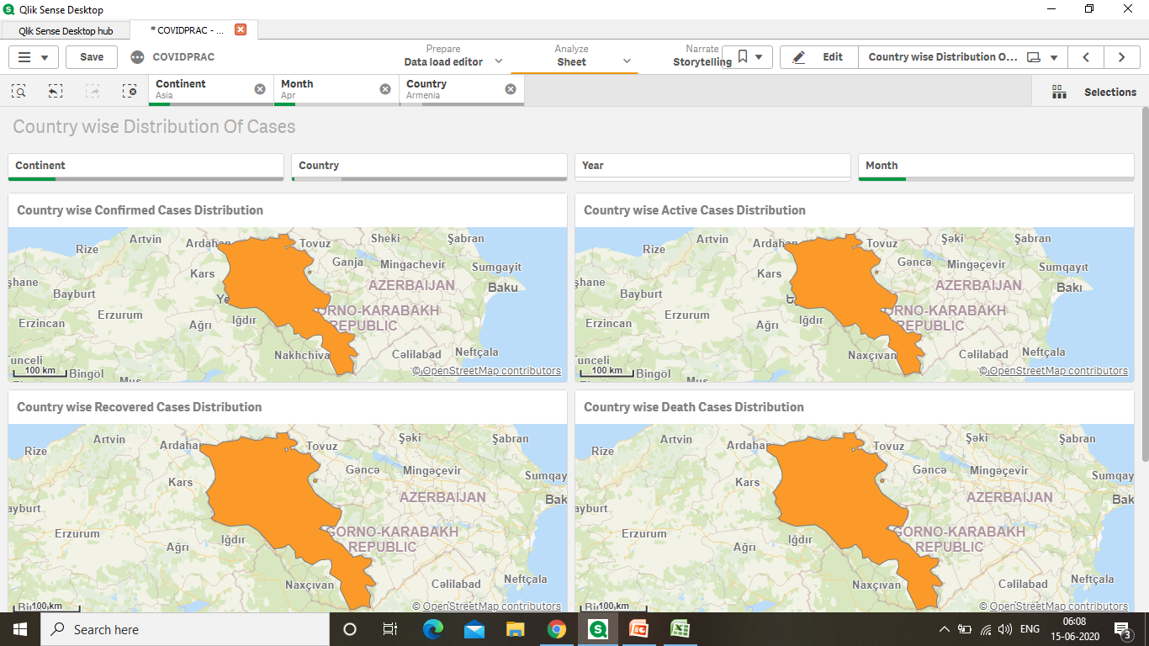

Slide 17
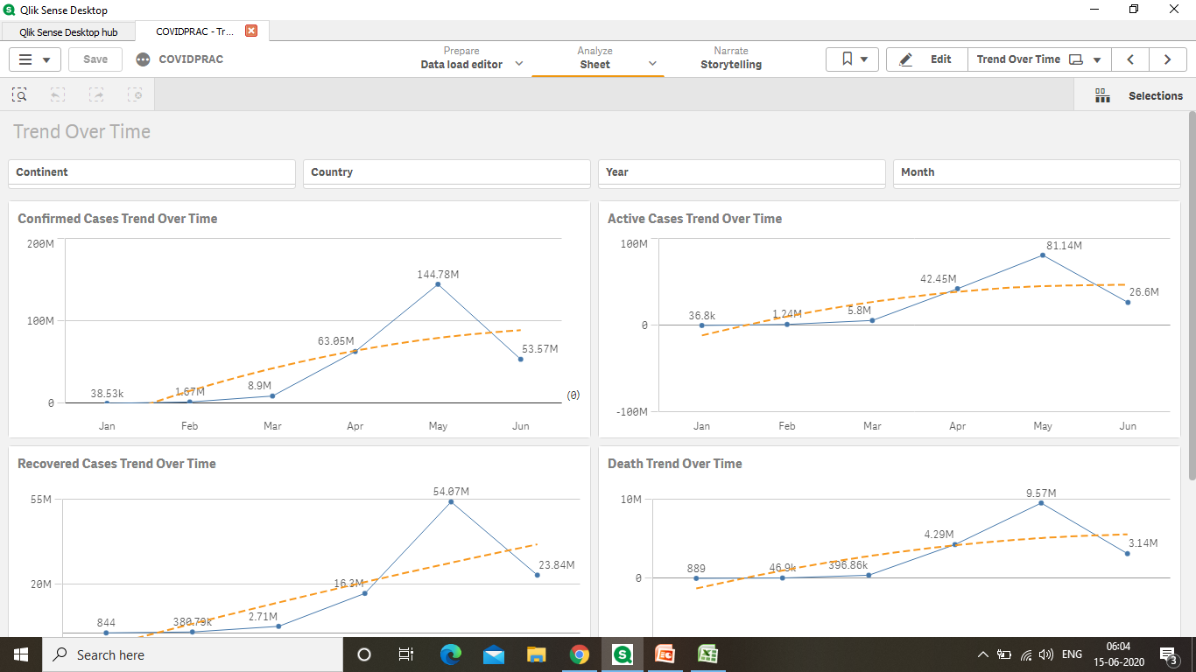
Trend Over Time

Slide 18
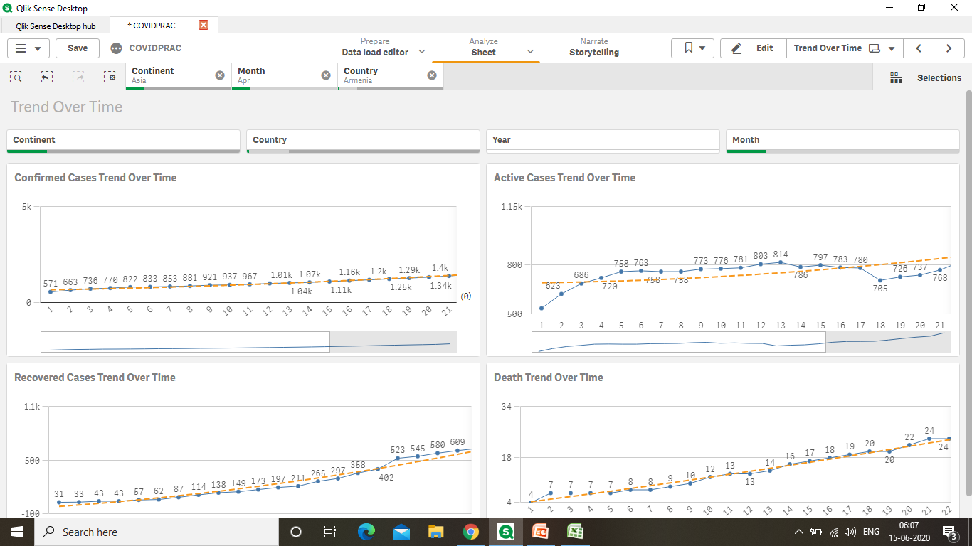
Trend over Time for April using Filter Pane

Slide 19
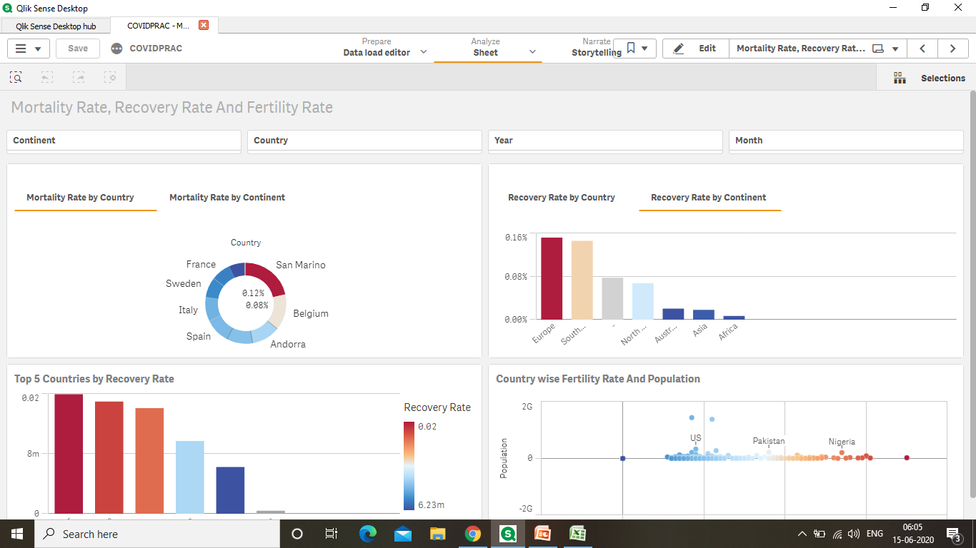
Mortality Rate, Recovery Rate and Fertility Rate

Slide 20
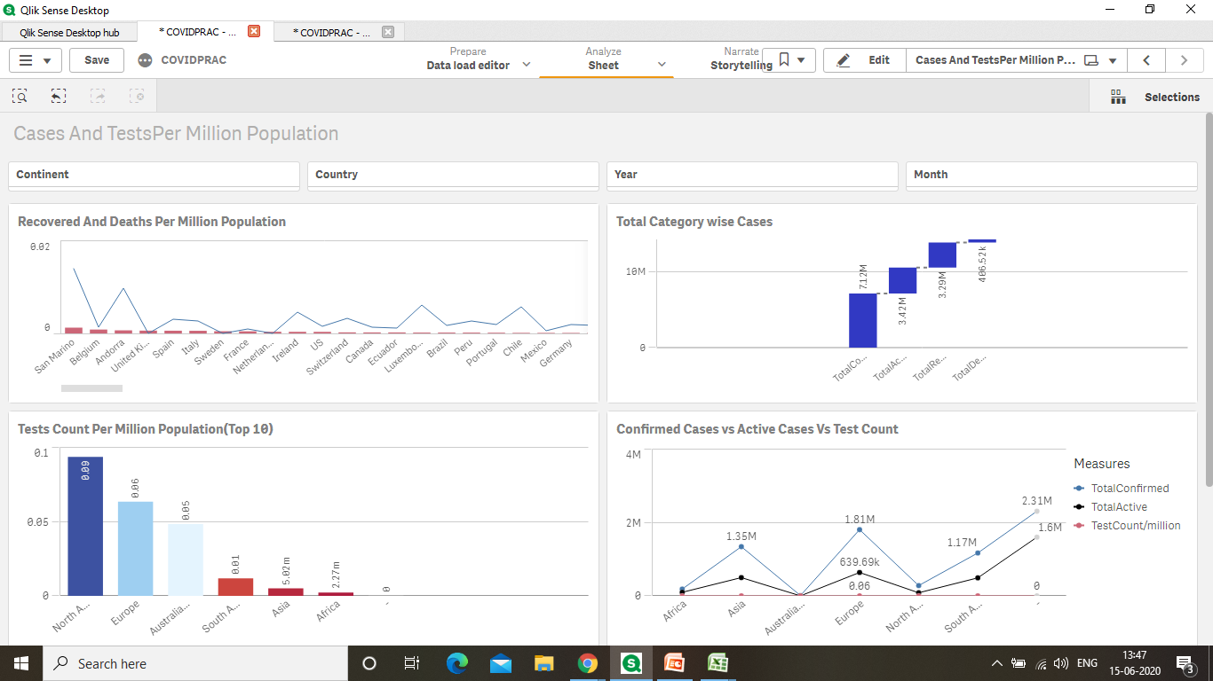
Cases And Tests per Million Population

Slide 21
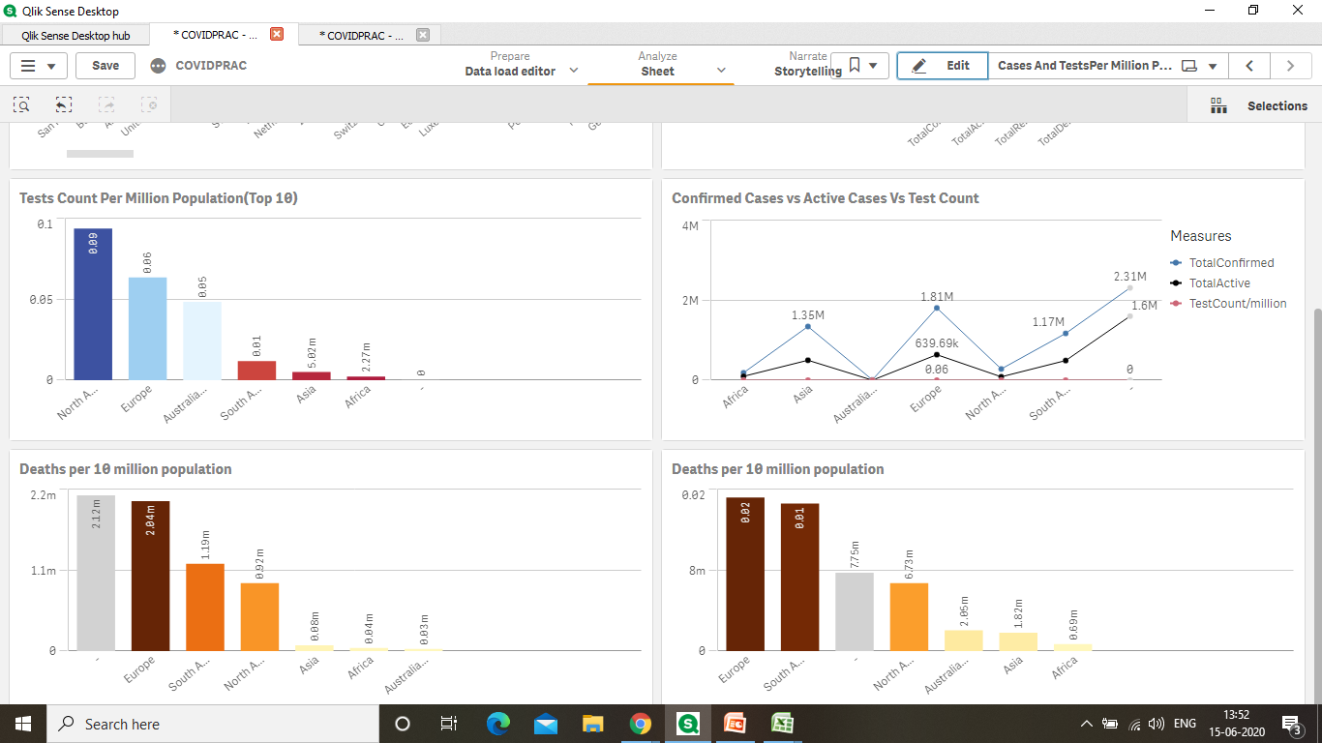

Slide 22
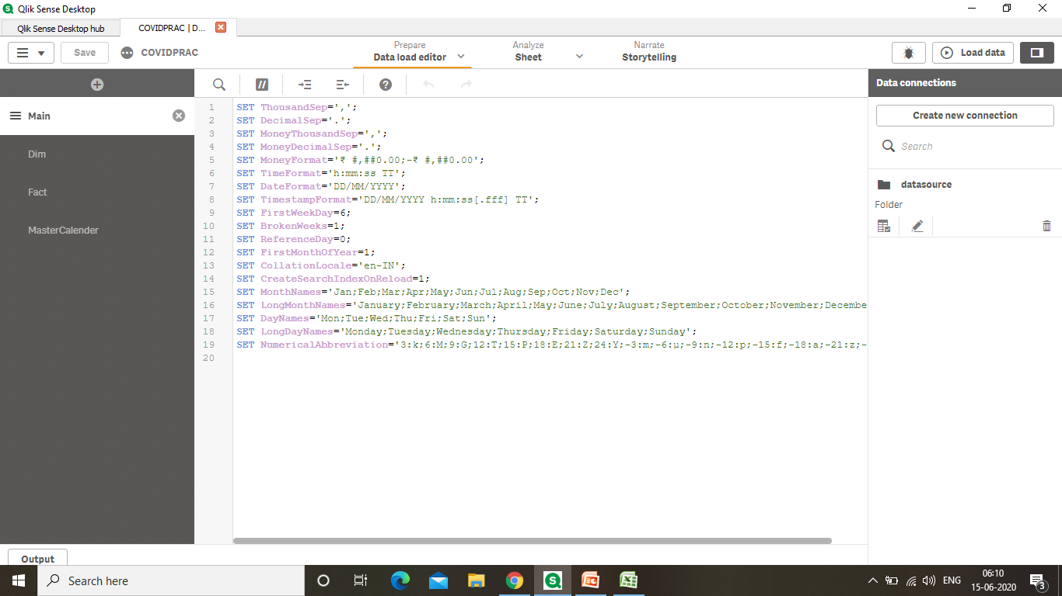
Script Editor Main:

Slide 23
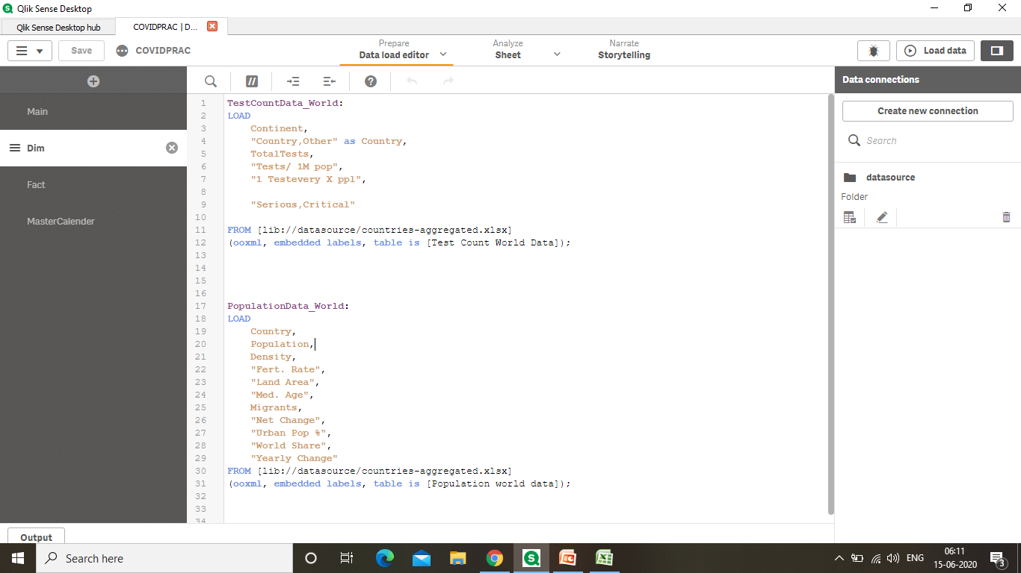
Dim:

Slide 24
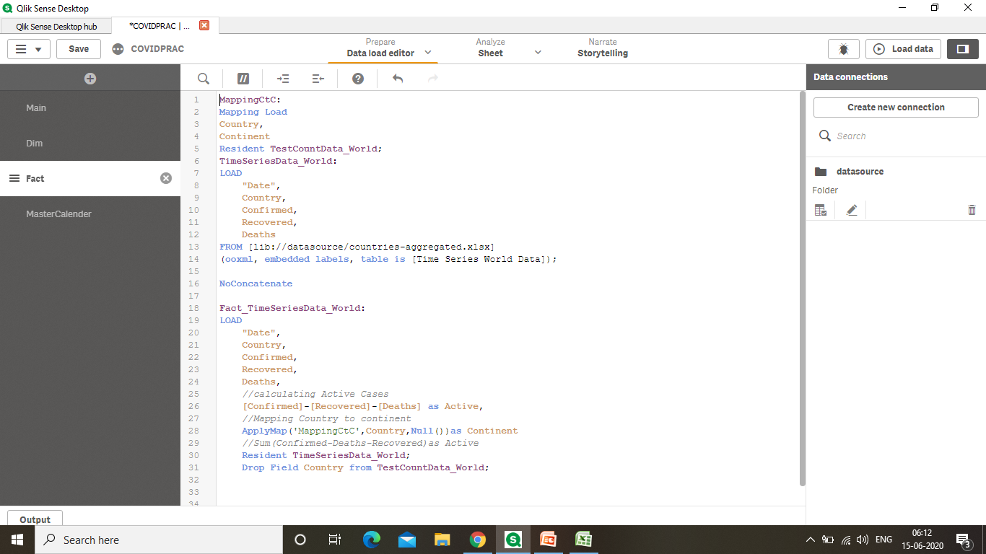
Fact:

Slide 25
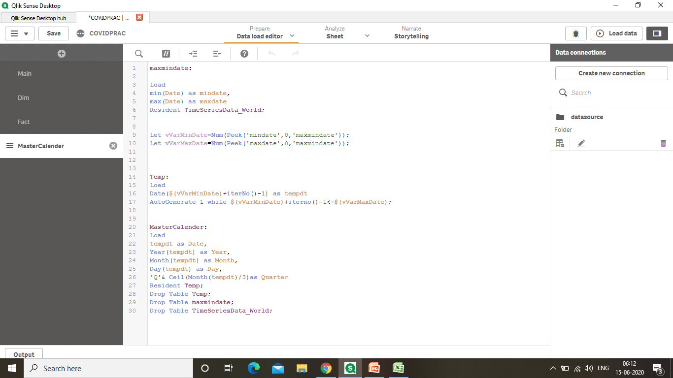
MasterCalender:

Slide 26
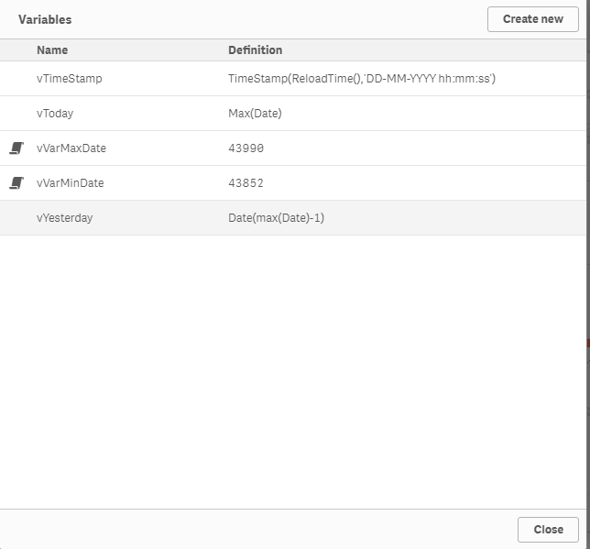
Variables Overview

Slide 27
Thank You!

